Slide 1
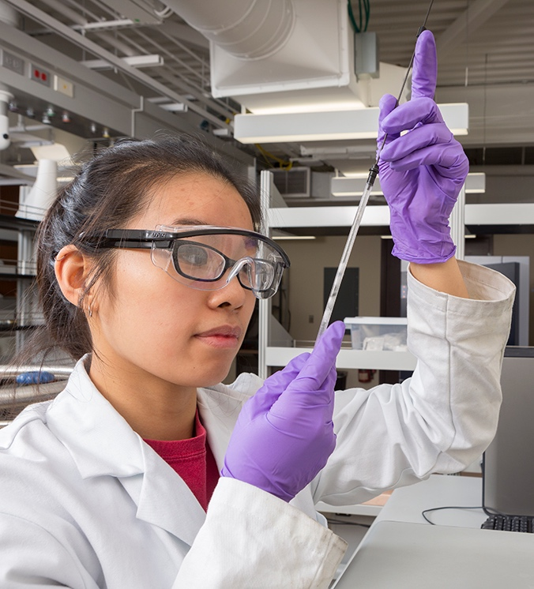

Drug Sensitivity Prediction Using Multi-Modal Data (GDSC Dataset)
Course: CS581/481A Multi-modal ML in Biomedicine
Team Members:
Balaji GV,
Bharath Kumar,
Karthik Maganahalli Prakash

Slide 2
Problem Statement
Objective: Predict drug response (LN_IC50) using multi-modal data (genomic + transcriptomic) across cancer cell lines.
Relevance: Tailors personalized cancer treatment by understanding which drugs are most effective for each cancer subtype.

Slide 3
Significance of the Problem
Drug response in cancer varies significantly between patients.
Leveraging large-scale datasets with genomics/transcriptomics can improve therapeutic decision-making.
Enables identification of biomarkers and drug repurposing opportunities.

Slide 4
Dataset Description
Dataset: GDSC (Genomics of Drug Sensitivity in Cancer)
Sample Size: ~240,000 rows, 19 key features
Key Modalities:
Genomics: CNA, Methylation, Mutations
Transcriptomics: Gene Expression
Drug Sensitivity: LN_IC50, AUC, Z_SCORE
Metadata: Tissue, MSI status, Cancer type, Target

Slide 5
Experimental Plan
Data Preprocessing & Imputation:
Per-drug mode-based imputation
KNN & Random Forest-based methods
Feature Encoding:
One-hot encoding for low-cardinality fields
Target encoding for high-cardinality features
Label encoding for IDs

Slide 6
Experimental Plan
Model Training:
Base Model: XGBoost Regressor
Hyperparameter Tuning: RandomizedSearchCV (20 combinations)
Model Evaluation:
RMSE, R², MAE
Feature Importance
SHAP Explanation

Slide 7
Algorithms Used
XGBoost Regressor: for high-accuracy regression on tabular data
RandomizedSearchCV: to tune XGBoost hyperparameters efficiently
KNN Imputer & RandomForestRegressor: for feature imputation
SHAP (SHapley Additive exPlanations): for model interpretability

Slide 8
Justification for Model Choices
CNNs & RNNs were not applicable due to lack of image/sequence data.
Classification models (like SVM/RandomForest Classifier) not suitable since target is continuous.
Focused on regression-based models for numerical LN_IC50 prediction.

Slide 9
Implementation Details
Language: Python
Libraries: pandas, numpy, sklearn, xgboost, shap, matplotlib, seaborn, plotly
Environment: Jupyter Notebook (Anaconda)

Slide 10
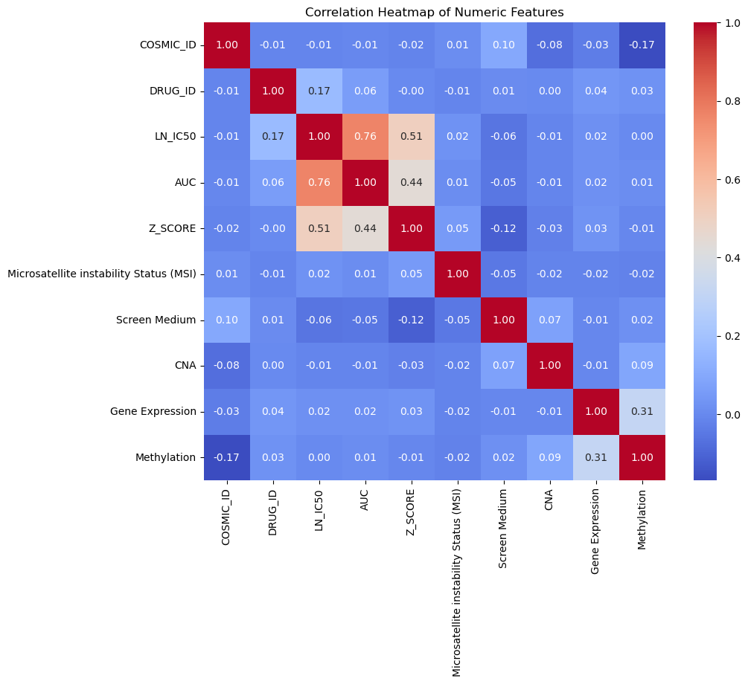
Visualizations
Correlation Heatmap

Slide 11
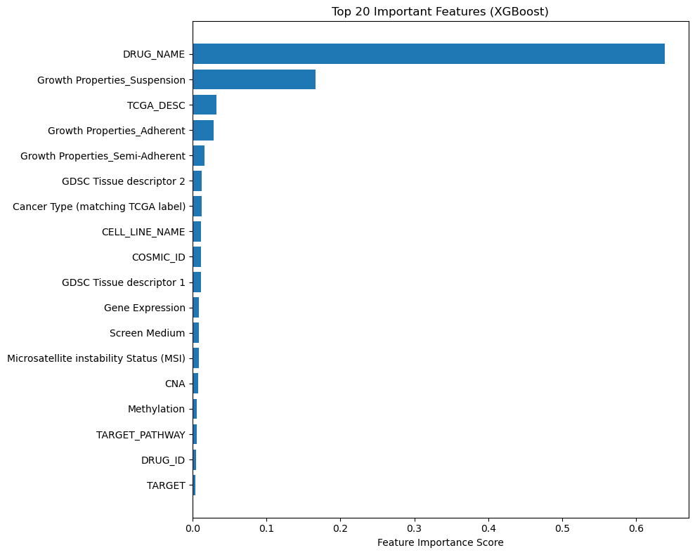
Visualizations
Feature Importance Plot (XGBoost)

Slide 12
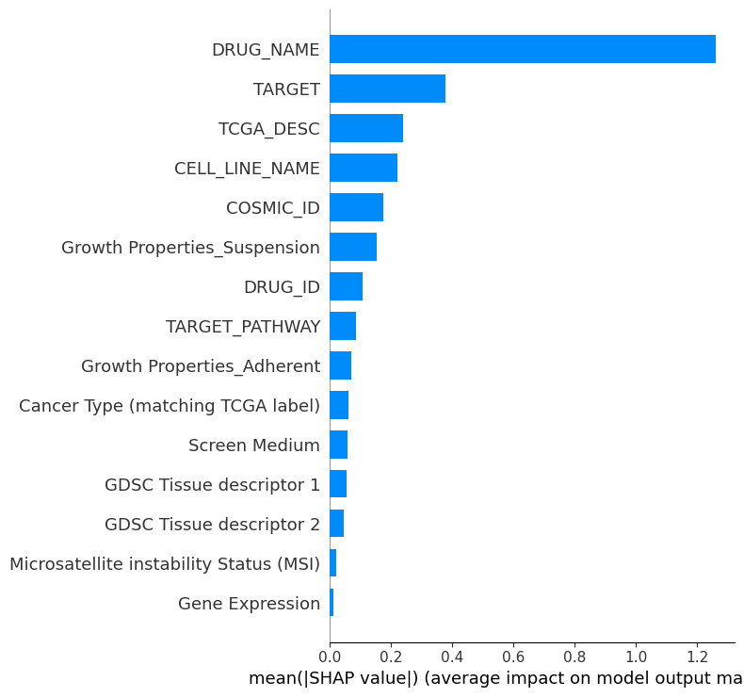
Visualizations
SHAP Summary Bar

Slide 13
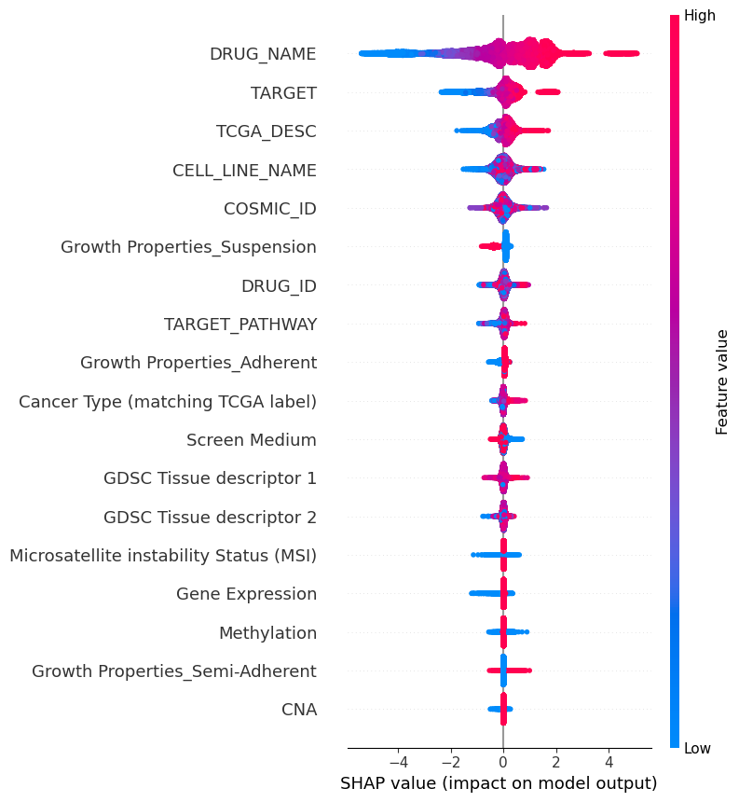
Visualizations
Beeswarm

Slide 14
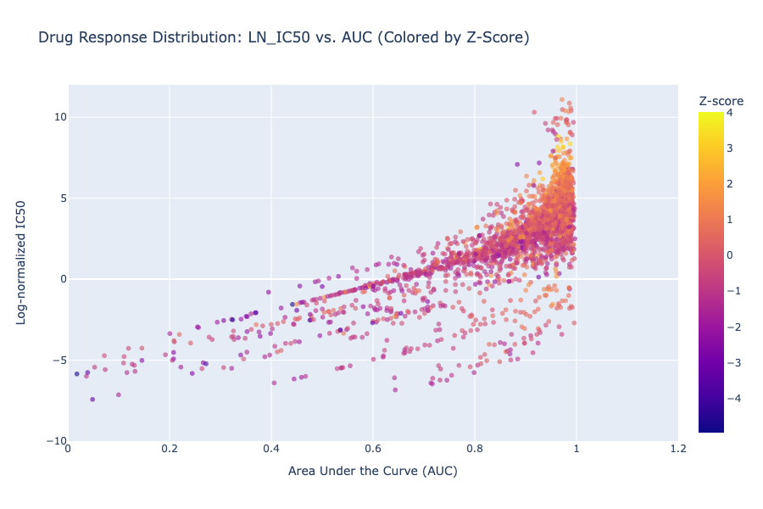
Visualizations
AUC vs LN_IC50 colored by Z-Score

Slide 15
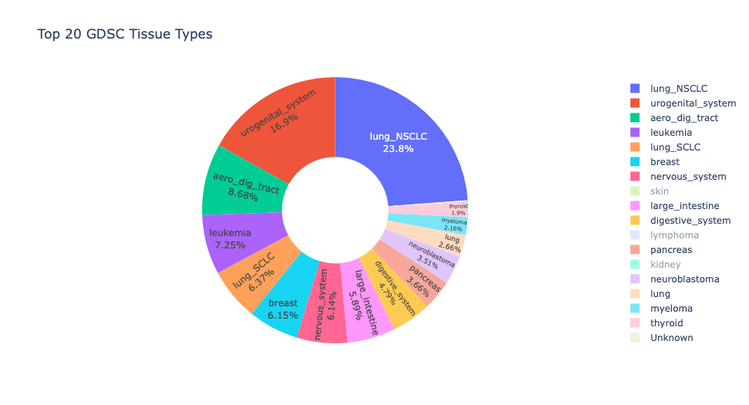
Visualizations
Donut Chart of Top Tissue Types

Slide 16
Results
Performance of Final Model (after tuning):
R² Score: 0.8543
RMSE: 1.0541
MAE: 0.7832
Key Features Identified:
TARGET, Gene Expression, CNA, DRUG_NAME, Tissue Descriptor 1

Slide 17
Limitations & Future Work
Many drugs lacked full TARGET annotation
Only regression on LN_IC50 was performed
Future Enhancements:
Incorporate more data modalities (e.g., proteomics)
Try LightGBM, ensemble stacking, AutoML
Build drug sensitivity classification labels (responder vs. non-responder)

Slide 18
Concluding Remarks
Built an interpretable ML pipeline for drug response prediction using GDSC.
Demonstrated strong predictive performance (R² > 0.85).
Identified biologically relevant predictors.
Model can support precision oncology research and future clinical tools.

Slide 19
THANK YOU!
Any questions?

